Slide 1
Processes Operating Systems Wenbo Shen

Slide 2
Recommendation

Slide 3
Processes
Process Concept
Process Control Block
Process State
Process Creation
Process Termination
Process and Signal
Process Scheduling

Slide 4
Process Concept
How to use computer resources, such as CPU, memory
A process is a program in execution (execution unit)
program: passive entity (bytes stored on disk as part of an executable file)
becomes a process when it’s loaded in memory
Multiple processes can be associated to the same program
on a shared server each user may start an instance of the same application (e.g., a text editor, the Shell)
A running system consists of multiple processes
OS processes, user processes
“job” and “process” are used interchangeably in OS texts

Slide 5
Process Concept
Process =
code (also called the text)
initially stored on disk in an executable file
program counter
points to the next instruction to execute (i.e., an address in the code)
content of the processor’s registers
a runtime stack
a data section
global variables (.bss and .data in x86 assembly)
a heap
for dynamically allocated memory (malloc, new, etc.)

Slide 6
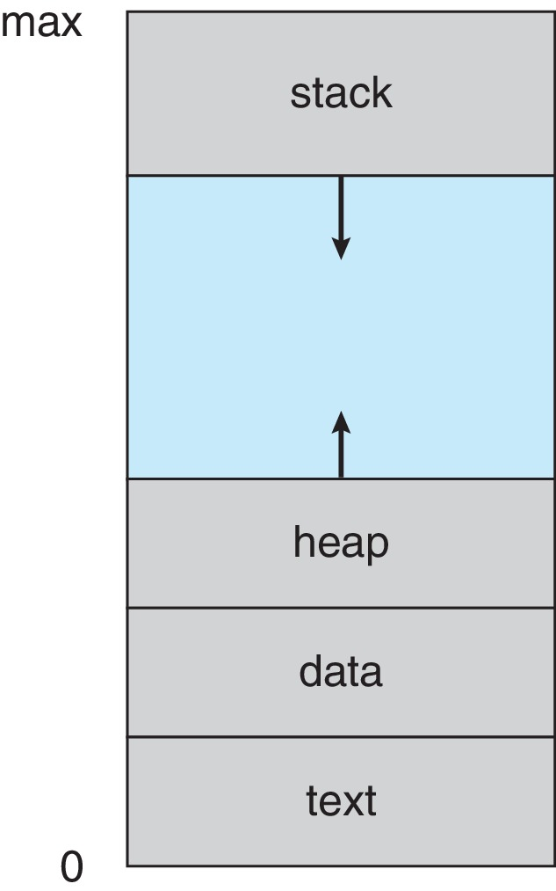
Process Address Space

Slide 7
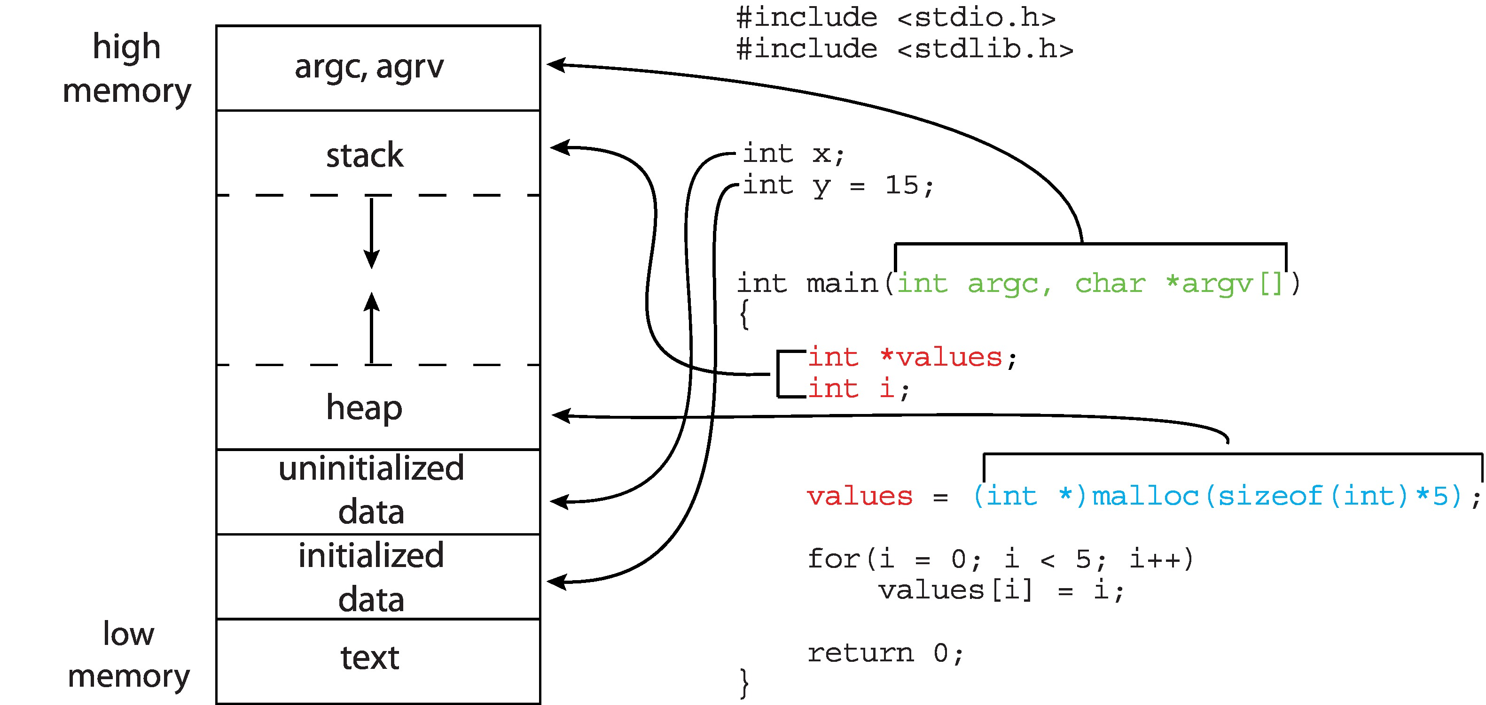
Memory Layout of a C Program

Slide 8
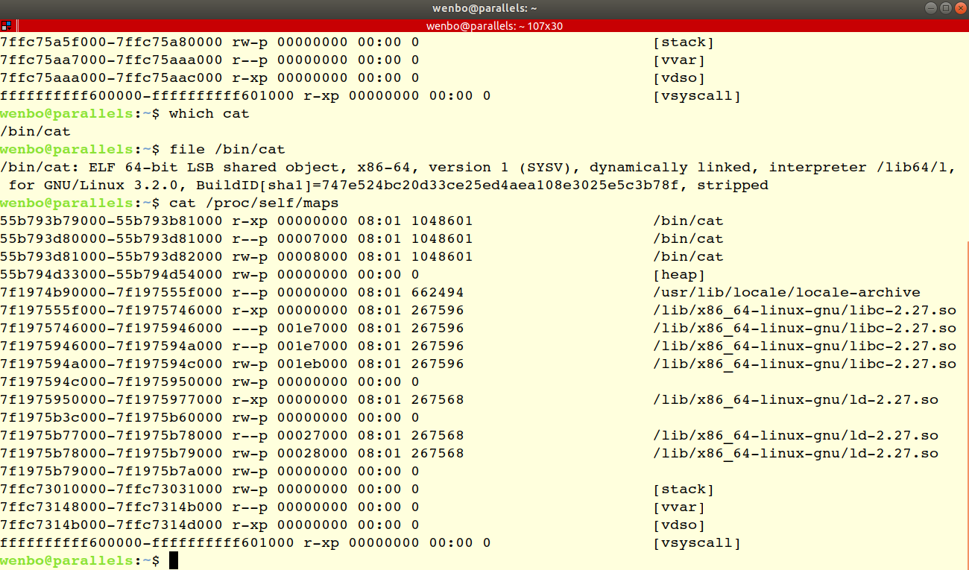
Process Address Space

Slide 9
The Stack
The runtime stack is
A stack on which items can be pushed or popped
The items are called activation records
The stack is how we manage to have programs place successive function/method calls
The management of the stack is done entirely on your behalf by the compiler
An activation record contains all the “bookkeeping” necessary for placing and returning from a function/method call

Slide 10
Activation Record
Any function needs to have some “state” so that it can run
The address of the instruction that should be executed once the function returns: the return address
Parameters passed to it by whatever function called it
Local variables
The value that it will return
Before calling a function, the caller needs to also save the state of its registers
All the above goes on the stack as part of activation records, which grows downward

Slide 11
Simple Runtime Stack
main() calls func(), which calls print()
a.r. for main()
a.r. for func()
a.r. for print()

Slide 12
Simple Runtime Stack
print() returns
a.r. for main()
a.r. for func()

Slide 13
Simple Runtime Stack
func() calls add(), which calls g()
a.r. for main()
a.r. for func()
a.r. for add()
a.r. for g()

Slide 14
Simple Runtime Stack
g() calls h()
a.r. for main()
a.r. for func()
a.r. for add()
a.r. for g()
a.r. for h()

Slide 15
Runtime Stack Growth
The mechanics for pushing/popping are more complex than one may think and pretty interesting
The longer the call sequence, the larger the stack
Especially with recursive calls!!
The stack can get too large
Hits some system-specified limit
Hits the heap
The famous “runtime stack overflow” error
Causes a trap, that will trigger the Kernel to terminate your process with that error
Typically due to infinite recursion

Slide 16
2 processes for the same program
stack
diff. size
diff. content
stack
heap
diff. size
diff. content
heap
data
same size
diff. content
data
text
same size
same content
text

Slide 17
Single- and Multi-Tasking
OSes used to be single-tasking
Modern OSes support multi-tasking
To start a new program, the OS simply creates a new process (via a system-call called fork() on a UNIX system)
stack
heap
process #3
data
free
memory
text
free memory
stack
process #2
stack
heap
process
heap
data
data
text
text
process #1
stack
command
interpreter
heap
kernel
kernel
data
text

Slide 18
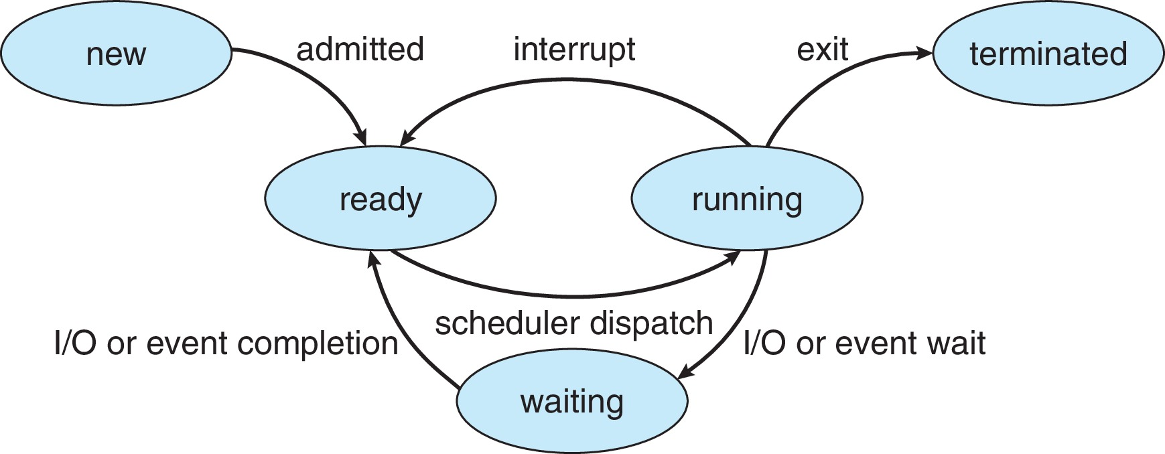
Process State
As a process executes, it changes state
New: The process is being created
Running: Instructions are being executed
Waiting: The process is waiting for some event to occur
Ready: The process is waiting to be assigned to a processor
Terminated: The process has finished execution

Slide 19
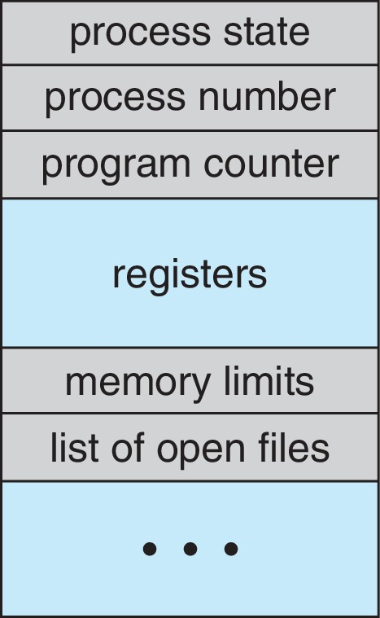
Process Control Block (PCB)
Information associated with each process
(also called task control block)
Process state – running, waiting, etc
Program counter – location of instruction to next execute
CPU registers – contents of all process-centric registers
CPU scheduling information- priorities, scheduling queue pointers
Memory-management information – memory allocated to the process
Accounting information – CPU used, clock time elapsed since start, time limits
I/O status information – I/O devices allocated to process, list of open files

Slide 20
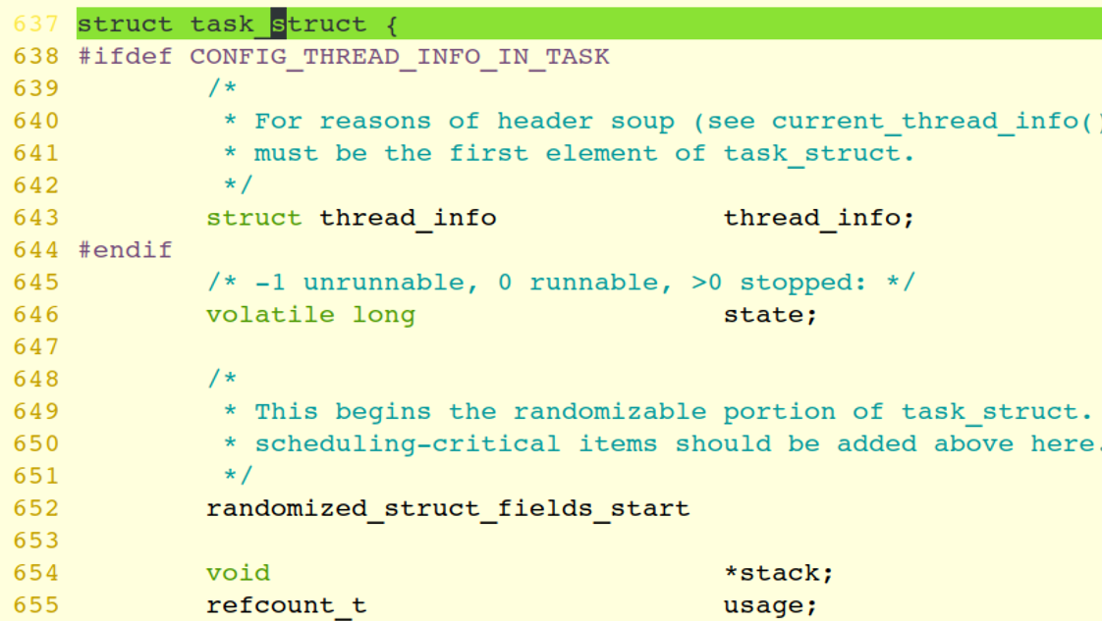
Process Representation in Linux
Represented by the C structure task_struct(https://elixir.bootlin.com/linux/v5.3.1/source/include/linux/sched.h#L637)

Slide 21
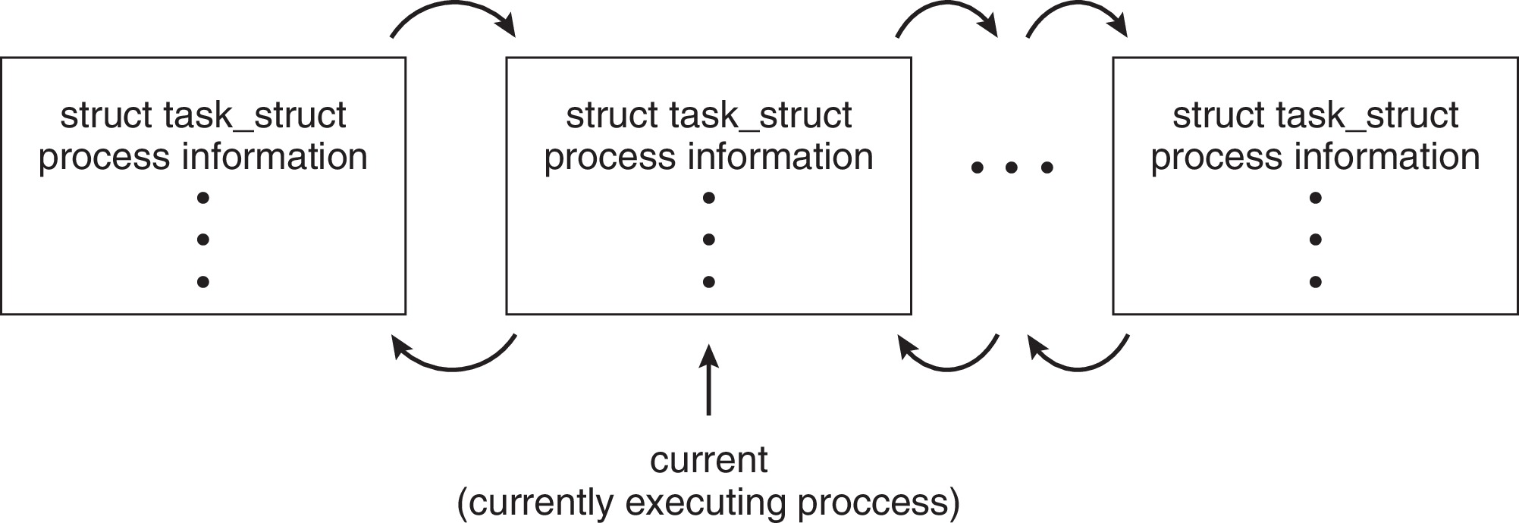
Process Representation in Linux
Represented by the C structure task_struct(https://elixir.bootlin.com/linux/v5.3.1/source/include/linux/sched.h#L637)
pid t_pid; /* process identifier */ long state; /* state of the process */ unsigned int time_slice /* scheduling information */ struct task_struct *parent;/* this process’s parent */ struct list_head children; /* this process’s children */ struct files_struct *files;/* list of open files */ struct mm_struct *mm; /* address space of this process */

Slide 22
Process State
As a process executes, it changes state
New: The process is being created
Running: Instructions are being executed
Waiting: The process is waiting for some event to occur
Ready: The process is waiting to be assigned to a processor
Terminated: The process has finished execution

Slide 23
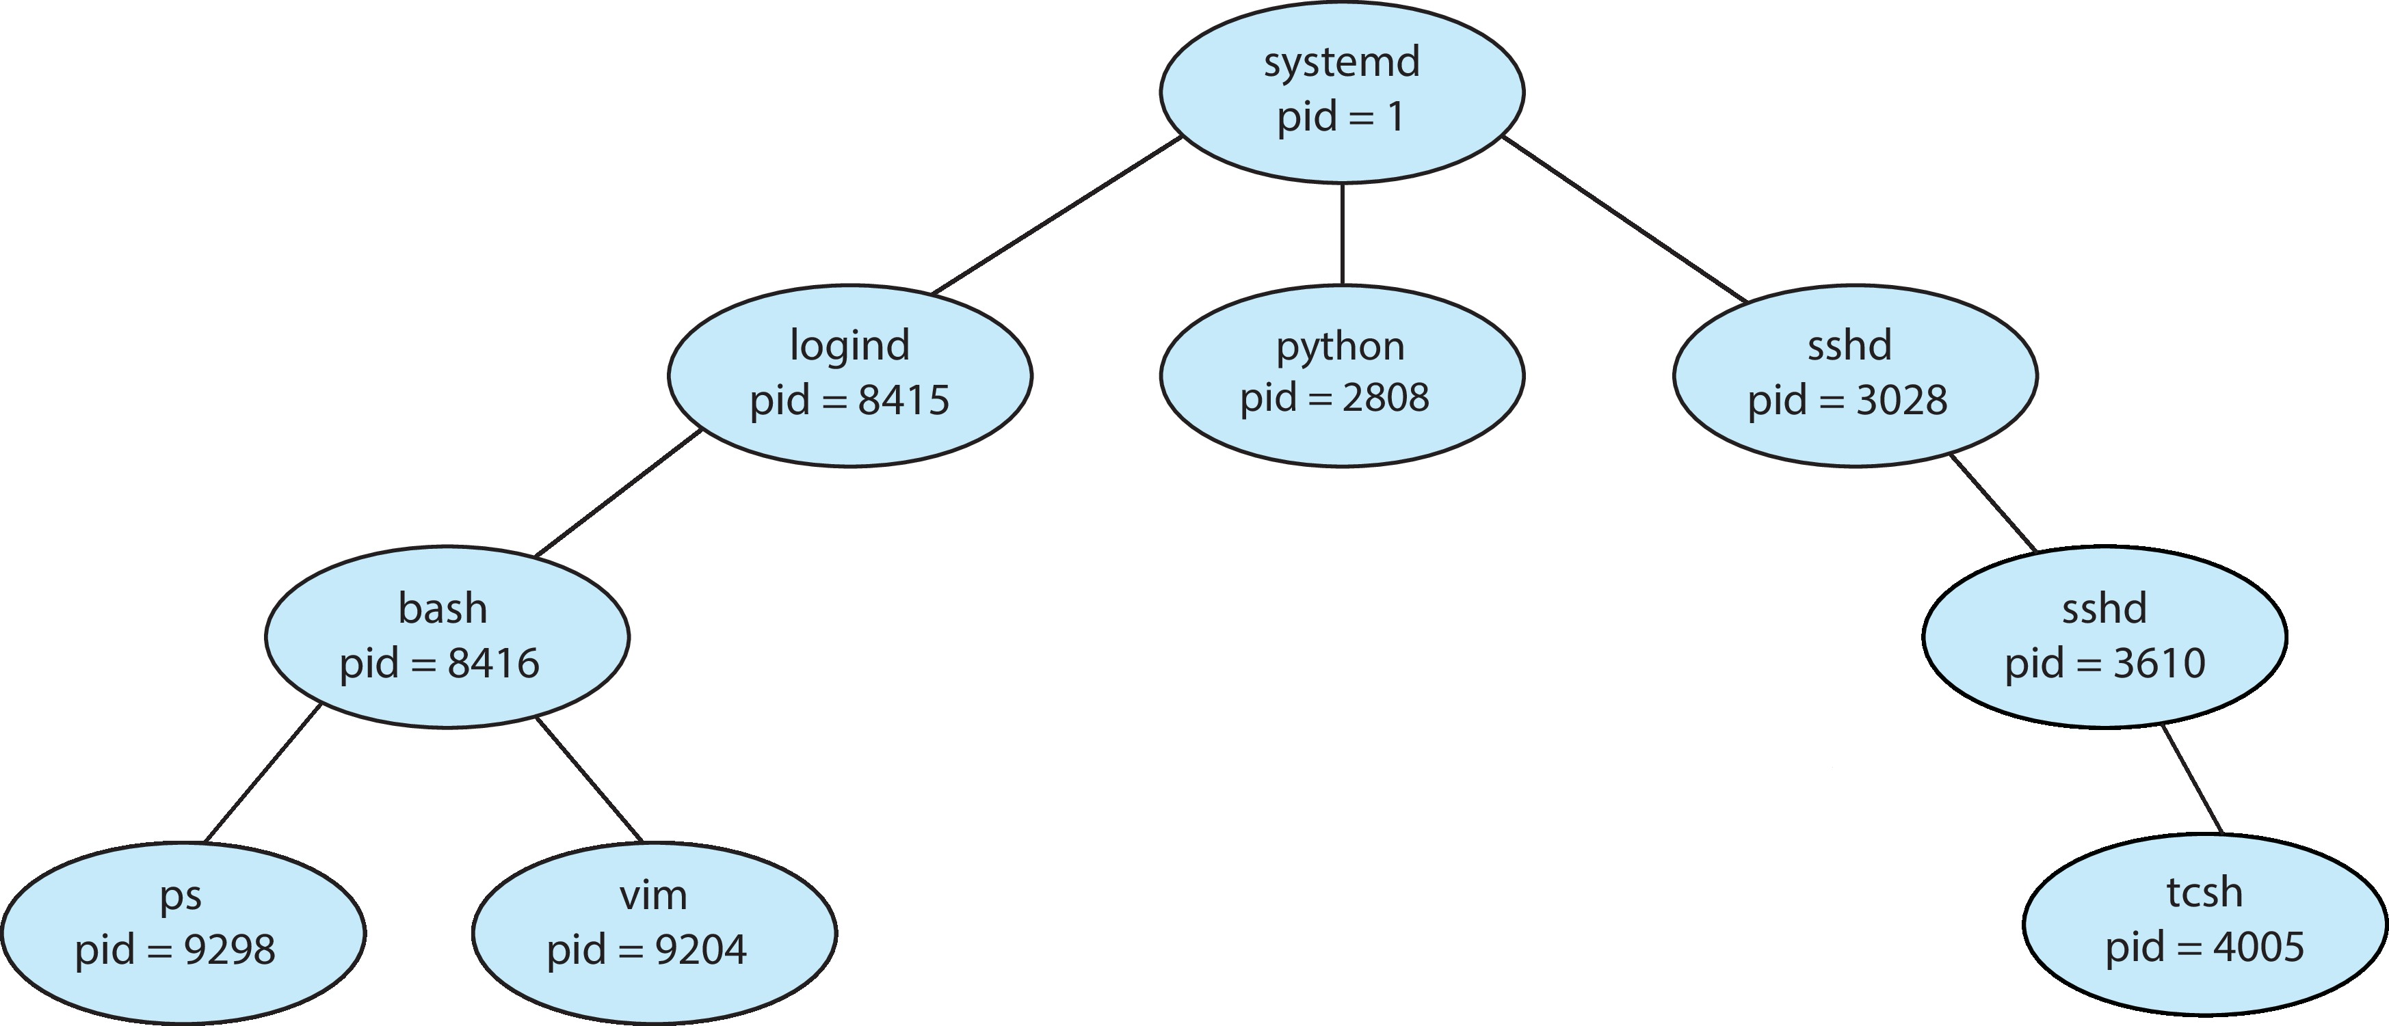
Process Creation
A process may create new processes, in which case it becomes a parent
We obtain a tree of processes
Each process has a pid
ppid refers to the parent’s pid
Example tree

Slide 24
Process Creation
The child may inherit/share some of the resources of its parent, or may have entirely new ones
Many variants are possible and we’ll look at what Linux does
A parent can also pass input to a child
Upon creation of a child, the parent can either
continue execution, or
wait for the child’s completion
The child could be either
a clone of the parent (i.e., have a copy of the address space), or
be an entirely new program
Let’s look at process creation in UNIX / Linux
You can read the corresponding man pages
“man 2 command” or “man 3 command”

Slide 25
The fork() System Call
fork() creates a new process
The child is is a copy of the parent, but...
It has a different pid (and thus ppid)
Its resource utilization (so far) is set to 0
fork() returns the child’s pid to the parent, and 0 to the child
Each process can find its own pid with the getpid() call, and its ppid with the getppid() call
Both processes continue execution after the call to fork()

Slide 26
fork() Example
pid = fork();
if (pid < 0) {
fprintf(stdout,”Error: can’t fork()\n”);
perror(“fork()”);
} else if (pid != 0) {
fprintf(stdout,”I am the parent and my child has pid %d\n”,pid);
while (1);
} else {
fprintf(stdout,”I am the child, and my pid is %d\n”, getpid());
while (1) ;
}
You should _always_ check error codes (as above for fork())
in fact, even for fprintf, although that’s considered overkill
I don’t do it here for the sake of brevity

Slide 27
fork() and Memory
What does the following code print?
int a = 12;
if (pid = fork()) { // PARENT
sleep(10); // ask the OS to put me in Waiting
fprintf(stdout,”a = %d\n”,a);
while (1);
} else { // CHILD
a += 3;
while (1);
}

Slide 28
fork() and Memory
What does the following code print?
int a = 12;
if (pid = fork()) { // PARENT
sleep(10); // ask the OS to put me in Waiting
fprintf(stdout,”a = %d\n”,a);
while (1);
} else { // CHILD
a += 3;
while (1);
}
Answer: 12

Slide 29
fork() and Memory
parent
child
stack
identical
stack
heap
identical
heap
data
a = 12
data
a = 12
identical
text
identical
text
State of both processes right after fork() completes

Slide 30
fork() and Memory
parent
identical but for extra activation record(s)
child
stack
stack
activation record for sleep
heap
identical
heap
data
a = 12
data
a = 15
identical but for a
text
identical
text
State of both processes right before sleep returns

Slide 31
fork() and Memory
parent
identical but for extra activation record(s)
child
stack
stack
activation record for fprintf
heap
identical
heap
data
a = 12
data
a = 15
identical but for a
text
identical
text
State of both processes right before fprintf returns (“12” gets printed)

Slide 32
fork() and Memory
How many times does this code print “hello”?
pid1 = fork();
fprintf(stdout,”hello\n”);
pid2 = fork();
fprintf(stdout,”hello\n”);

Slide 33
fork() and Memory
How many times does this code print “hello”?
pid1 = fork();
fprintf(stdout,”hello\n”);
pid2 = fork();
fprintf(stdout,”hello\n”);
Answer: 6 times
Notes:
Main process 2 times
Pid1 2 times
Pid 2 1 time

Slide 34
Popular Homework Question
How many processes does this C program create?
int main (int argc, char *arg[])
{
fork ();
if (fork ()) {
fork ();
}
fork ();
}
Typical C coding style: call fork() and if its return value is non-zero and do the if clause

Slide 35
Popular Homework Question
How many processes does this C program create?
int main (int argc, char *arg[])
{
fork ();
if (fork ()) {
fork ();
}
fork ();
}
original process right when main begins

Slide 36

Popular Homework Question
How many processes does this C program create?
int main (int argc, char *arg[])
{
fork ();
if (fork ()) {
fork ();
}
fork ();
}
fork ()
Call to fork() creates a copy of the original process

Slide 37
Popular Homework Question
How many processes does this C program create?
int main (int argc, char *arg[])
{
fork ();
if (fork ()) {
fork ();
}
fork ();
}
We now have two independent processes, each about to execute the same code

Slide 38
Popular Homework Question
How many processes does this C program create?
int main (int argc, char *arg[])
{
fork ();
if (fork ()) {
fork ();
}
fork ();
}
We now have two independent processes, each about to execute the same code
This code calls fork

Slide 39

Popular Homework Question
How many processes does this C program create?
int main (int argc, char *arg[])
{
fork ();
if (fork ()) {
fork ();
}
fork ();
}
fork() returns non-0
fork() returns non-0
fork() returns 0
fork() returns 0

Slide 40
Popular Homework Question
How many processes does this C program create?
int main (int argc, char *arg[])
{
fork ();
if (fork ()) {
fork ();
}
fork ();
}
fork() returns non-0
fork() returns non-0
fork() returns 0
fork() returns 0
yellow and green: don’t go into the if clause
red and blue: go!!

Slide 41


Popular Homework Question
How many processes does this C program create?
int main (int argc, char *arg[])
{
fork ();
if (fork ()) {
fork ();
}
fork ();
}
red and blue each creates a new child process (purple an brown)

Slide 42
Popular Homework Question
How many processes does this C program create?
int main (int argc, char *arg[])
{
fork ();
if (fork ()) {
fork ();
}
fork ();
}
ALL processes execute the last call to fork()
red, purple, blue and brown after they exit from the if clause
yellow and green after they skip the if clause
We have 6 processes calling fork(), each creating a new process
So we have a total of 12 processes at the end, one of which was the original process

Slide 43
Process Creation (Cont.)
Address space
Child duplicate of parent
Child has a program loaded into it
UNIX examples
fork() system call creates new process
exec() system call used after a fork() to replace the process’ memory space with a new program
Parent process calls wait() for the child to terminate

Slide 44
The exec*() Family of Syscalls
The “exec” system call replaces the process image by that of a specific program
see “man 3 exec” to see all the versions
Standard names of such functions in C are execl, execle, execlp, execv, execve, and execvp, but not “exec” itself. The Linux kernel has one corresponding system call named “execve”, whereas all aforementioned functions are user-space wrappers around it. （https://en.wikipedia.org/wiki/Exec_(system_call)）
Try man 2 execve
Essentially one can specify:
path for the executable
command-line arguments to be passed to the executable
possibly a set of environment variables
An exec() call returns only if there was an error

Slide 45
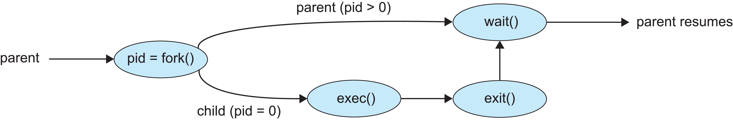
The exec*() Family of Syscalls
The “exec” system call replaces the process image by that of a specific program
if (fork() == 0) { // runs ls
char *const argv[] = {“ls”, “-l”,”/tmp/”,NULL};
execv(“/bin/ls”, argv);
}

Slide 46
Process State
As a process executes, it changes state
New: The process is being created
Running: Instructions are being executed
Waiting: The process is waiting for some event to occur
Ready: The process is waiting to be assigned to a processor
Terminated: The process has finished execution

Slide 47
Process Terminations
A process terminates itself with the exit() system call
This call takes as argument an integer that is called the process’ exit/return/error code
All resources of a process are deallocated by the OS
physical and virtual memory, open files, I/O buffers, ...
A process can cause the termination of another process
Using something called “signals” and the kill() system call

Slide 48
wait() and waitpid()
A parent can wait for a child to complete
The wait() call
blocks until any child completes
returns the pid of the completed child and the child’s exit code
The waitpid() call
blocks until a specific child completes
can be made non-blocking with WNOHANG options
Read the man pages (“man 2 waitpid”)

Slide 49
Processes and Signals
A process can receive signals, i.e., software interrupts
It is an asynchronous event that the program must act upon, in some way
Signals have many usages, including process synchronization
We’ll see other, more powerful and flexible process synchronization tools
The OS defines a number of signals, each with a name and a number, and some meaning
See /usr/include/sys/signal.h or “man signal”
Signals happen for various reasons
^C on the command-line sends a SIGINT signal to the running command
A segmentation violation sends a SIGBUS signal to the running process
A process sends a SIGKILL signal to another

Slide 50
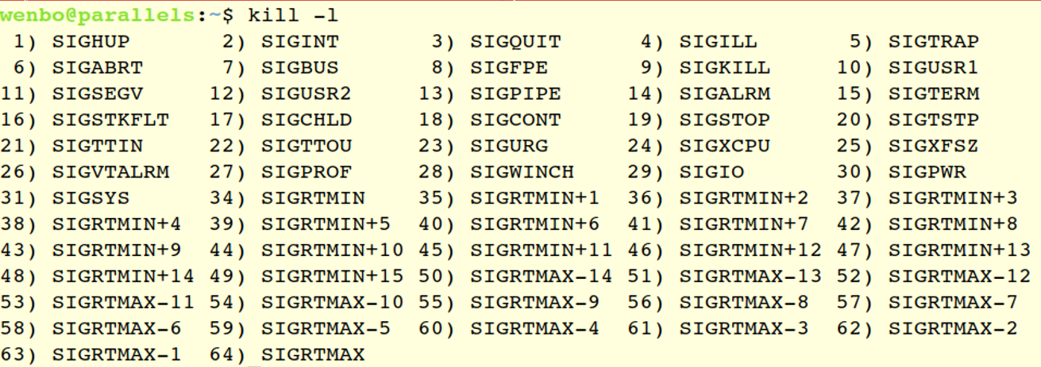
Processes and Signals
Kill command

Slide 51
Manipulating Signals
Each signal causes a default behavior in the process
e.g., a SIGINT signal causes the process to terminate
But most signals can be either ignored or provided with a user-written handler to perform some action
Signals like SIGKILL and SIGSTOP cannot be ignored or handled by the user, for security reasons
The signal() system call allows a process to specify what action to do on a signal:
signal(SIGINT, SIG_IGN); // ignore signal
signal(SIGINT, SIG_DFL); // set behavior to default
signal(SIGINT, my_handler); // customize behavior
handler is as: void my_handler(int sig) { ... }
Let’s look at a small example of a process that ignores SIGINT

Slide 52
Signal Example
#include <signal.h>
#include <stdio.h>
void handler(int sig) {
fprintf(stdout,”I don’t want to die!\n”);
return;
}
main() {
signal(SIGINT, handler);
while(1); // infinite loop
}
Notes:
DEMO

Slide 53
Process State
As a process executes, it changes state
New: The process is being created
Running: Instructions are being executed
Waiting: The process is waiting for some event to occur
Ready: The process is waiting to be assigned to a processor
Terminated: The process has finished execution

Slide 54
Process Scheduling
Maximize CPU use, quickly switch processes onto CPU core
Process scheduler selects among available processes for next execution on CPU core
Maintains scheduling queues of processes
Ready queue – set of all processes residing in main memory, ready and waiting to execute
Wait queues – set of processes waiting for an event (i.e. I/O)
Processes migrate among the various queues

Slide 55
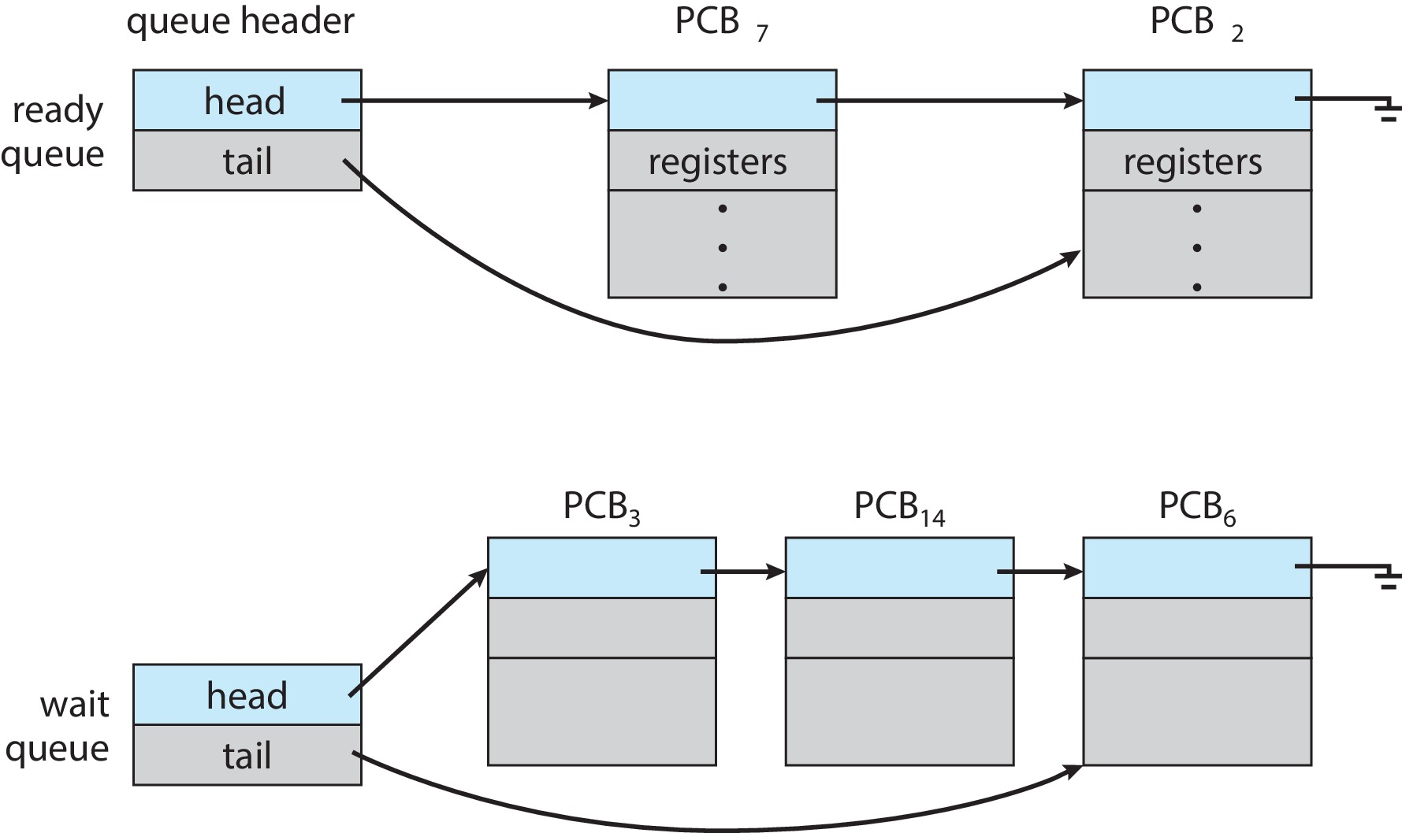
Ready and Wait Queues
struct list_head {
struct list_head *next, *prev;
};
https://elixir.bootlin.com/linux/v5.2.8/source/include/linux/types.h#L181

Slide 56
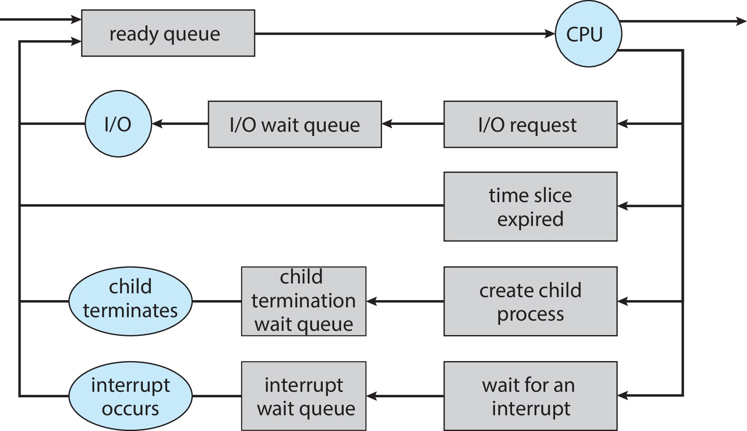
Representation of Process Scheduling

Slide 57
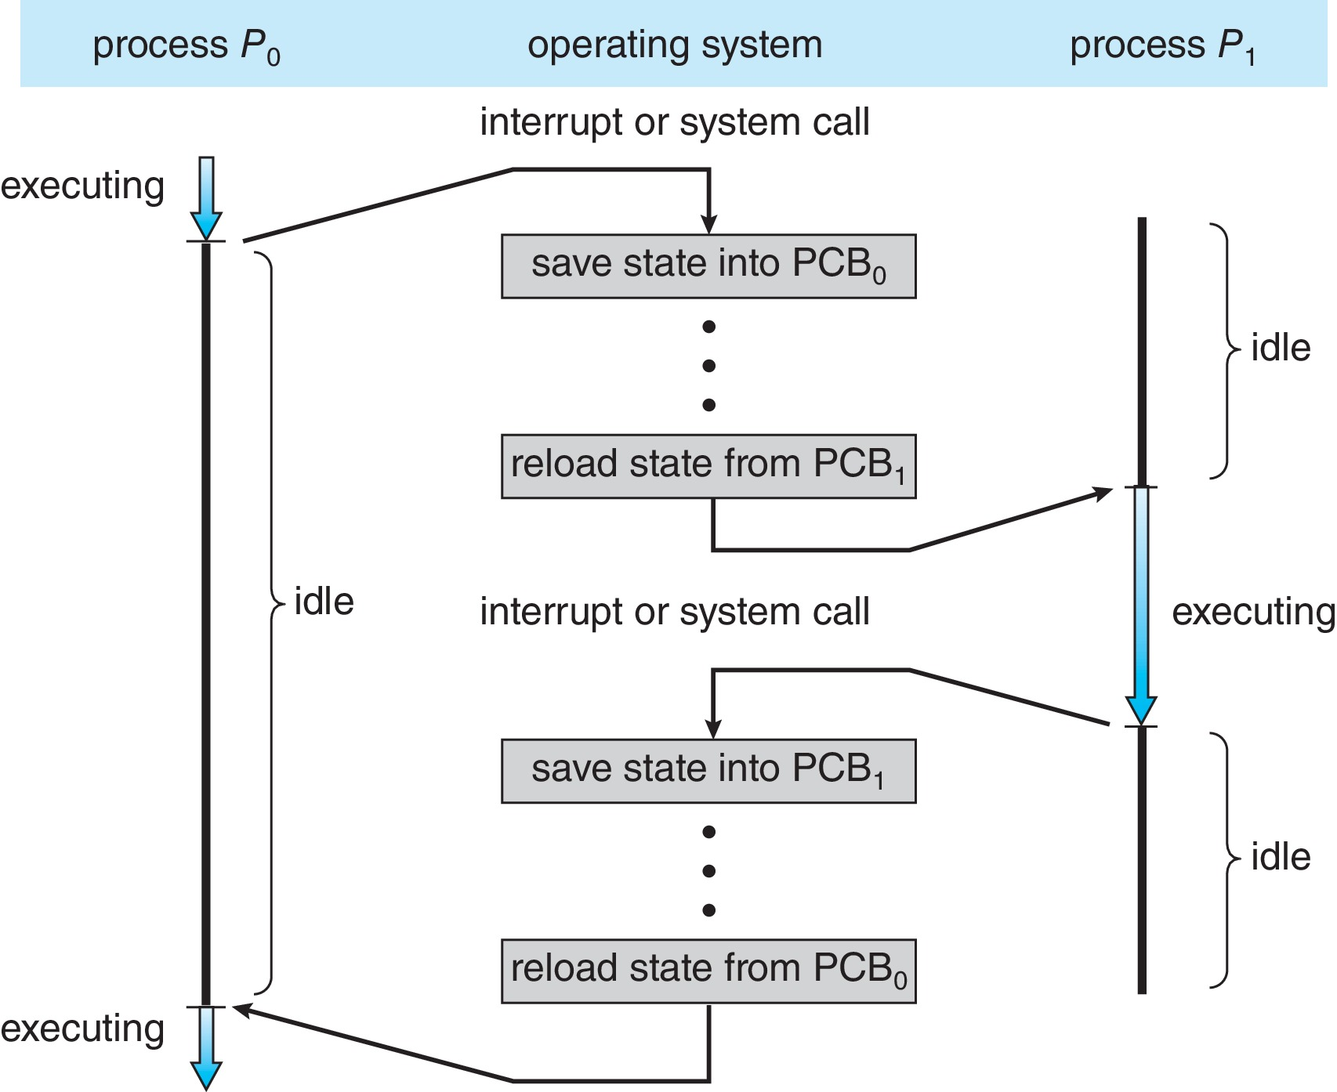
CPU Switch From Process to Process
A context switch occurs when the CPU
switches from one process to another.

Slide 58
Context Switch
When CPU switches to another process, the system must save the state of the old process and load the saved state for the new process via a context switch
Context of a process represented in the PCB
Context-switch time is overhead; the system does no useful work while switching
The more complex the OS and the PCB ➔ the longer the context switch
Time dependent on hardware support
Some hardware provides multiple sets of registers per CPU ➔ multiple contexts loaded at once

Slide 59
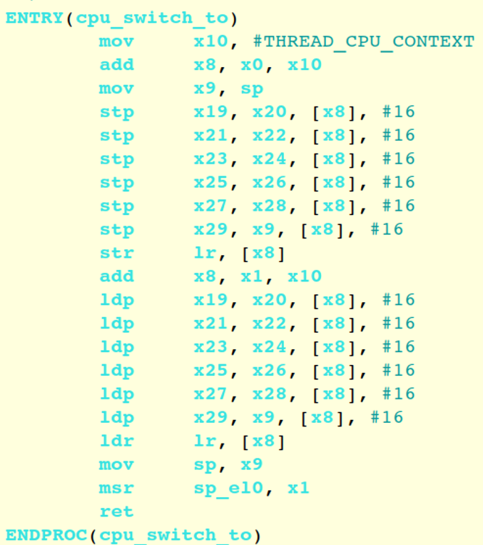
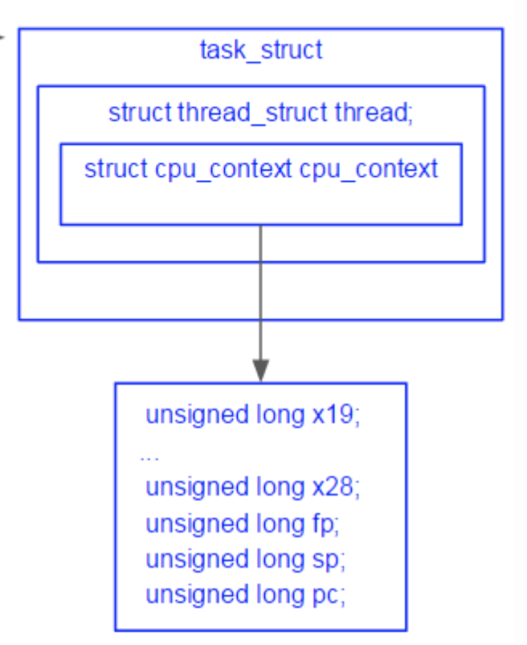
Context Switch

Slide 60
Context Switch
Most important step is
STACK SWITCHING
Move sp to general reg
Save old sp
Load new sp
Move new sp to sp reg

Slide 61
Takeaway
Process Concept
Process vs Program
Process Control Block
task_struct
Process State
Five states, who has a queue
How to create and terminate a process
Process Scheduling
Where are registers saved?
Switch steps
Homework 1 deadline is this Thursday
Lab0 deadline TBD

